Slide 1
ZapStream
[VIPS-TC / Artificial Intelligence and Data Science] · Academic Year 2023–2027
Paste a video link. Download the full video or one part, and turn any tutorial into a study PDF.
Team Member | Roll No. | Guide / Mentor
ARUN | 60617711924
ASHUTOSH SINGH | 60817711924

Slide 2
Problem Statement & Motivation
The real-world problem
Why existing solutions fall short
Tutorials run 30 to 120 minutes, but a student usually needs just one concept or chapter.
Revising means re-watching the whole video and writing notes by hand.
Slow or costly internet makes repeated streaming hard.
Downloaders save only the full file; no option to take one part.
They stop at the file: no notes, summary, glossary or quiz.
Cloud AI note tools need accounts, paid keys and upload student data.
Problem statement: Students need one simple tool that turns a video link into what they actually study: the full video or only the needed part, plus ready-made study notes. Today this takes several apps and a lot of manual work.
ZapStream · Project Presentation
2 / 18

Slide 3
Proposed Solution & Objectives
ZapStream takes a video link, shows its details, downloads the full video or only a chosen time range, and turns the video captions into a study PDF using a local AI model.
01 Smart info and download
02 AI-written study PDF
03 Simple and private
Paste a link to see title, channel, duration, views and likes. Pick MP4 (1080p to 360p) or MP3, and cut a part with start and end time.
Captions are split into parts. The AI writes concepts, examples, steps, a glossary, a revision sheet and a quiz.
The backend starts when VS Code opens the folder. Ollama runs the AI on the laptop: free, offline and private.
SDG 4, Quality Education: students can revise from a short clip or a PDF instead of re-watching hours of video, even with limited internet.
ZapStream · Project Presentation
3 / 18

Slide 4
Unique Selling Proposition & Key Features
Feature | How it works | Benefit
Instant video details | yt-dlp reads the link and returns title, channel, duration, views, likes and thumbnail | Know the video before downloading
Full video or one part | Start and end time go to download_ranges; ffmpeg cuts that range only | Smaller files, faster saves
Many formats | MP4 in 1080p, 720p, 480p, 360p, or MP3 audio through ffmpeg | Fits any device or data limit
AI study PDF | Captions become section-wise notes by Ollama (or Claude API); the browser saves the PDF | Complete revision material
Auto-start workflow | A VS Code task runs start.py when the folder opens; then click Go Live | No repeated commands
ZapStream · Project Presentation
4 / 18

Slide 5
System Architecture / High-Level Design
STEP 1
STEP 2
STEP 3
STEP 4
STEP 5
User Request
FastAPI Backend
yt-dlp + ffmpeg
AI Notes Engine
Output
Link, format and optional start and end time typed in index.html
backend.py receives the request and starts a background job
Reads video info, downloads, cuts the range, converts to MP3 or MP4
Captions are split into parts; Ollama writes notes, glossary and quiz
Video file or study PDF (html2pdf.js) downloads in the browser
→
→
→
→
Live progress: the browser asks /api/job/{id} every second and shows a progress bar. After the file is sent, the temporary folder is deleted automatically.
ZapStream · Project Presentation
5 / 18

Slide 6
Tech Stack & Tools Used
Layer | Technology | Role in the project
Frontend | HTML5, CSS3, JavaScript, html2pdf.js | Input form, progress bar, notes preview, PDF export
Backend | Python, FastAPI, Uvicorn | REST API and background job handling
Media | yt-dlp, ffmpeg | Read video info, download, cut ranges, convert to MP3
AI | Ollama (llama3.2), optional Claude API | Writes notes, glossary and quiz
Transcript | YouTube captions (VTT), optional faster-whisper | Source text for the study notes
Dev tools | VS Code, Live Server, tasks.json | One-click start workflow
ZapStream · Project Presentation
6 / 18

Slide 7
Project Structure & Startup Flow
Project folder
How it starts without commands
MINOR PROJECT/
|-- .vscode/
| |-- tasks.json auto-start
| \-- settings.json Live Server
|-- backend.py API + AI notes
|-- index.html user interface
|-- start.py launcher
|-- start.bat manual backup
\-- .env model / key
Open the folder in VS Code.
tasks.json runs python start.py on folderOpen.
start.py installs missing packages, skips if port 8000 is busy, then runs Uvicorn.
Click Go Live. index.html talks to http://127.0.0.1:8000.
Header shows a green dot when the server is connected.
ZapStream · Project Presentation
7 / 18

Slide 8
Code Summary: backend.py (API)
Endpoint | What the code does | Key point
GET /api/info | yt-dlp extract_info(download=False) returns title, channel, views, likes, formats | Nothing is downloaded
POST /api/download | Starts run_download in a thread with format, start and end | download_range_func cuts the part
POST /api/notes | Starts run_notes: captions, sections, AI notes | Works on full video or a range
GET /api/job/{id} | Returns status, progress, message and result | Browser polls every second
GET /api/file/{id} | Sends the finished file, then deletes the temp folder | Automatic clean-up
GET /api/health | Reports ffmpeg found and AI provider (ollama, claude or none) | Drives the green status dot
Design idea: a JOBS dictionary plus background threads keep the page responsive during long downloads and AI notes.
ZapStream · Project Presentation
8 / 18

Slide 9
Code Summary: Study Notes Pipeline
Study notes pipeline
Key lines of code
pick_sub() chooses English or Hindi captions (VTT).
parse_vtt() removes tags and repeated lines.
make_sections() splits by chapters or about 5-minute blocks.
ask_llm() sends SECTION_PROMPT; AI replies in JSON (concepts, steps, takeaways).
FINAL_PROMPT adds overview, glossary, quiz and revision sheet.
Fallback: summarize() picks key sentences if AI is off.
Cut only the chosen part
download_range_func(None, [(start, end)])
Pick the AI automatically
ai_provider() # claude, ollama, None
Ask the model for notes
parse_json(ask_llm(SECTION_PROMPT))
No captions? Transcribe audio
WhisperModel("base").transcribe(f)
ZapStream · Project Presentation
9 / 18

Slide 10
Code Summary: index.html (Frontend)
Part of index.html | Key code | What it does
Design and theme | CSS variables, .zapbar, dark mode | Responsive page with light and dark theme
Server status | health() every 5 seconds | Green dot and "AI: ollama" label
Find video | fetch("/api/info") | Fills title, channel, views, likes, formats
Full video or part | getRange(), parseTime() | Checks start and end such as 1:30 and 4:45
Job runner | runJob() polls /api/job/{id} | Live progress bar for download and notes
Study PDF | renderNotes(), html2pdf().save() | Builds the notes page and saves the PDF
Error handling | errMsg(), isNetErr() | Separates server-offline from other errors
ZapStream · Project Presentation
10 / 18

Slide 11
Code Summary: Automation Files
File | Purpose | Key setting or line
tasks.json | VS Code task that starts the backend | "runOn": "folderOpen", command python start.py
settings.json | Live Server rules | Port 5500; ignores *.py and .vscode
start.py | One-file launcher | Installs missing packages, updates yt-dlp weekly, then uvicorn.run("backend:app")
start.bat | Manual backup | Double-click to run python start.py
.env | Chooses the AI without code changes | OLLAMA_MODEL=llama3.2 or ANTHROPIC_API_KEY=...
Why it matters: the student only opens the folder and clicks Go Live. No terminal commands are needed after the first setup.
ZapStream · Project Presentation
11 / 18

Slide 12
Commands Used: Setup & Run
Command | Purpose
pip install fastapi uvicorn yt-dlp | Install the backend libraries
winget install ffmpeg | Install ffmpeg for merging, cutting and MP3
ollama pull llama3.2 | Download the local AI model (about 2 GB)
ollama list | Check that the model is installed
python start.py | Launcher used by tasks.json: installs, then starts the server
python -m uvicorn backend:app --reload --port 8000 | Manual way to start the API on port 8000
http://127.0.0.1:8000/api/health | Browser check; expect "ai":"ollama" in the reply
ZapStream · Project Presentation
12 / 18

Slide 13
Commands Used: Troubleshooting & Fixes
Problem | Command | Result
Is ffmpeg installed? | ffmpeg -version | Version details appear
Is Ollama installed? | ollama --version | Version number appears
Port 8000 is busy | netstat -ano | findstr :8000 | PID shown on the LISTENING line
Stop the old server | taskkill /PID <PID> /F | Port is free for the new server
Downloads start failing | python -m pip install -U yt-dlp | Latest yt-dlp handles site changes
Command not found after installing? Reload PATH in PowerShell:
$env:Path = [System.Environment]::GetEnvironmentVariable("Path","Machine") + ";" + [System.Environment]::GetEnvironmentVariable("Path","User")
ZapStream · Project Presentation
13 / 18

Slide 14
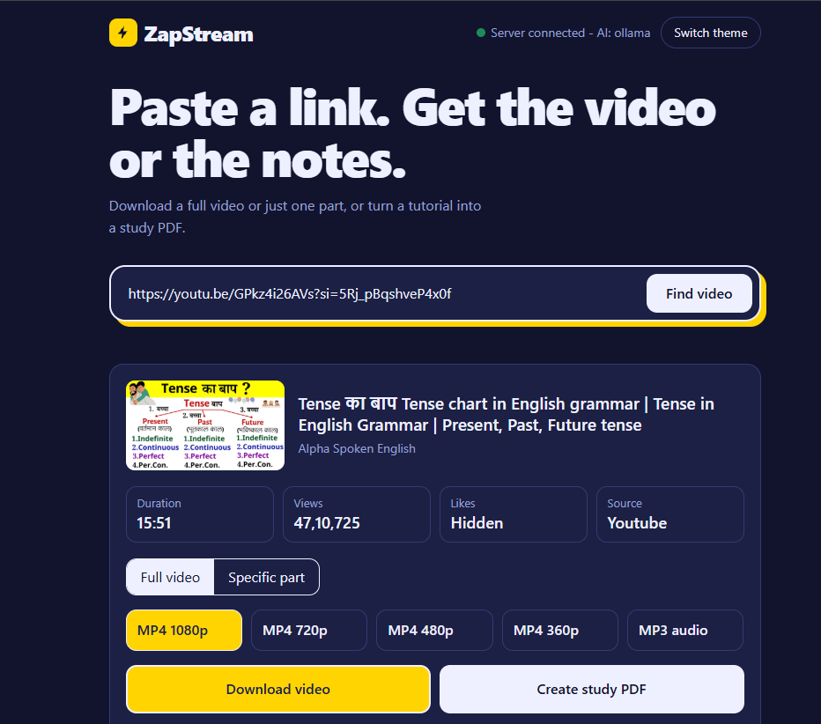
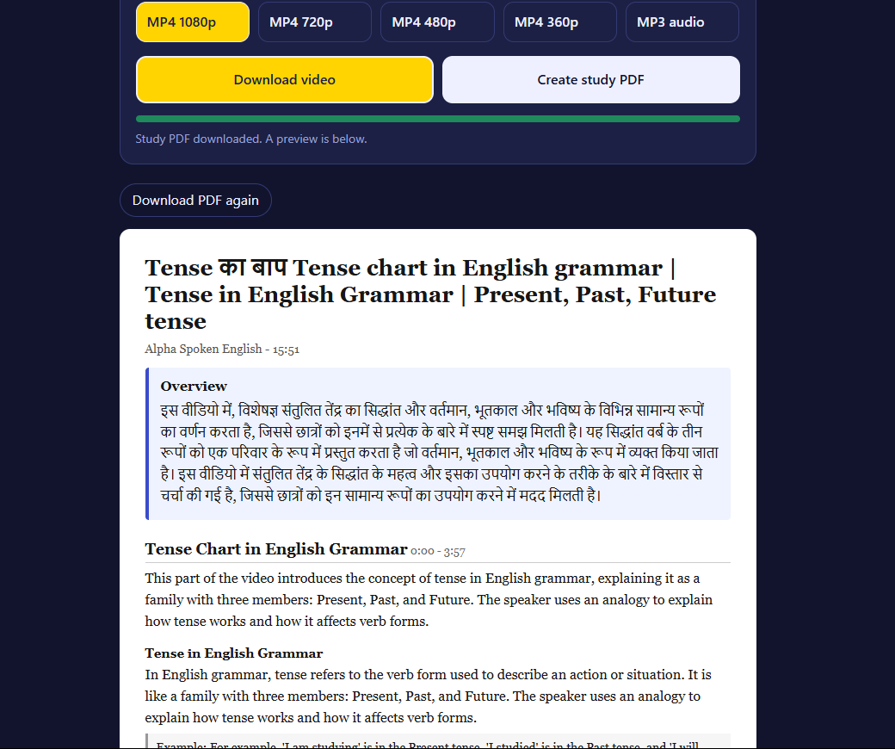
Live Demo / Output Screenshots
Input: ZapStream web page
Output: video details and study PDF
[Add screenshot of the UI]
[Add screenshot of results]
Example link: a 5-minute English tutorial
Example output: clip or MP3, study PDF
ZapStream · Project Presentation
14 / 18

Slide 15
Performance / Comparison Matrix
Parameter | Traditional downloader | ZapStream
Video details first | URL and quality only | Title, channel, duration, views, likes
Download a part | Not available | Start and end time cut
Formats | Often limited | MP4 in four qualities, plus MP3
Notes and revision | None | Study PDF with concepts, glossary, quiz
Privacy | Cloud tools upload data | Local AI (Ollama) stays on the laptop
Daily effort | Install and run commands | Open VS Code, click Go Live
ZapStream · Project Presentation
15 / 18

Slide 16
Future Scope & Enhancements
Enhancement | Benefit
Better Hindi and multi-language notes | Supports more regional-language lectures
Flashcards and printable quiz sheets | Faster self-testing before exams
Playlist to full-course notes | One PDF for an entire course
Browser extension | Start from the video page itself
Cloud deployment with login | Use ZapStream from any device
ZapStream · Project Presentation
16 / 18

Slide 17
Conclusion & Key Takeaways
01 Problem
02 Solution
03 Impact
Long tutorials waste time and data. Students need one part and good notes, but tools only save whole files.
ZapStream shows video details, downloads the full video, one part or MP3, and writes a study PDF with a local AI.
Faster revision, lower data use and free, private AI. Supports SDG 4 (Quality Education) and SDG 9 (Innovation).
Key takeaway: ZapStream turns any tutorial link into a video clip and a study PDF, in one click, on the student’s own laptop.
ZapStream · Project Presentation
17 / 18

Slide 18
Thank You
Questions and feedback are welcome.
ARUN, ASHUTOSH SINGH ·

